Slide 1



Shared Service Operation
Finance Center

Slide 2
ORGANIZATION STRUCTURE

Slide 3
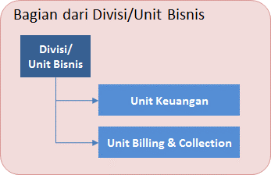
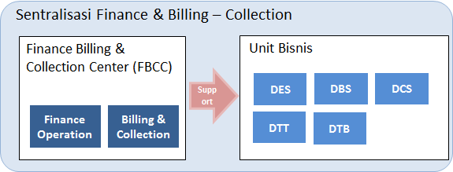
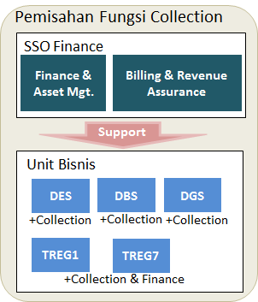
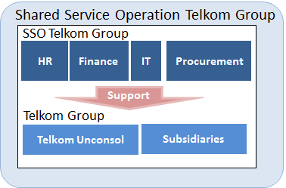
ORGANIZATION JOURNEY SSO FINANCE
< 2006
2006
2010
2014-Now
Next
 | Finance per Divisi/Ubis | Finance Center | Finance & Billing Collection | Telkom Regional & Collection Ubis | Shared Service Operation
Type | Desentralisasi | Sentralisasi | Sentralisasi | Semi Desentralisasi | Shared Sumber Daya
Generate | Bentuk organisasi divisionalisasi dan end to end tanggung jawab | Independensi & Objectivitas pencatatan transaksi keuangan Implementasi ERP SAP | Independensi & Objectivitas pencatatan billing (revenue) Sentralisasi proses billing dan mesin billing | Penguatan layanan Telkom Regional Collection menjadi tanggungjawab Unit Bisnis | Trend Global Optimalisasi sumber daya Telkom Group Efisiensi biaya Telkom Group Standarisasi proses bisnis Telkom Group Unit bisnis dan subsidiary fokus pada bisnis
Perubahan | Fungsi keuangan, billing & collection berada di masing-masing divisi/unit bisnis | Dibentuknya unit finance center yang terpisah dari Unit Bisnis | Billing & Collection bergabung dengan Finance Center | Dibentuknya unit Payment Collection & Finance di Regional Pemisahan fungsi collection ke Unit Bisnis | Layanan keuangan ke Telkom Group
Structure

Slide 4
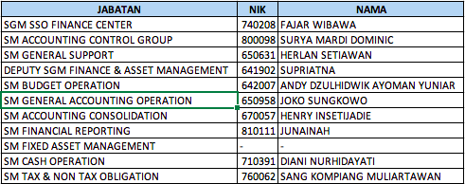
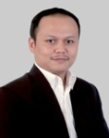
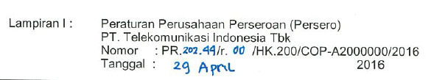
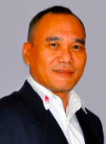

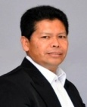



















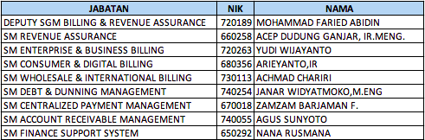

STRUKTUR ORGANISASI SSO FINANCE (PR. 202.44)
WAHYU
AMC

Slide 5
STRUKTUR ORGANISASI FINANCE & ASSET MGT
SGM SSO FINANCE CENTER
Mgr General Administrasi
Mgr Logistic Support
Mgr Unit Program & Performance
Mgr Quality Management
Mgr Consolidation Controller
Mgr Accounting Controller Parent
Mgr Accounting Controller Subsidary
SM GENERAL SUPPORT
SM ACCOUNTING CONTROLLER GROUP
DEPUTY FINANCE & ASSET MANAGEMENT
DEPUTY BILLING & REVENUE ASSURANCE
ACCOUNTING CONSOLIDATION
FINANCIAL REPORTING
FIXED ASSET MANAGEMENT
BUDGET OPERATION
CASH OPERATION
TAX & NON TAX OBLIGATION
GENERAL ACC. OPERATION
Mgr Consolidation Process
Mgr Reciprocal Elimination 01
Mgr Reciprocal Elimination 02
Mgr Financial Statement
Mgr Disclosure Reporting
Mgr Financial Reporting Review
Mgr Asset Accounting
Mgr Asset Existence & Database
Mgr Asset Optimization Management
Mgr Asset Insurance
Mgr Energy Management
Mgr Budget Opex Group Business 01
Mgr Budget Opex Group Business 02
Mgr Budget Capex
Mgr Reporting & Analysis
Mgr Cash In
Mgr Cash Out
Mgr Cash Evaluation & Monitoring
Mgr Corporate Tax
Mgr PPH Operation Control
Mgr PPN Operation Control
Mgr Non Tax Obligation
Mgr Accounting Assessment
Mgr Accounting Operation
Mgr Accounting Intercompany
FINANCE CENTER BUSINES PARTNER (01 - 05 )

Slide 6
STRUKTUR ORGANISASI FCBP (01 - 05) BERBASIS CFU
SGM SSO FINANCE CENTER
DEPUTY FINANCE & ASSET MANAGEMENT
DEPUTY BILLING & REVENUE MGT
FCBP 01
FCBP 02
FCBP 03
FCBP 04
FCBP 05
MGR ACCOUNTING ASESSMENT & BUDGET OPERATION
MGR ACCOUNTING OPERATION & REPORTING TELKOM REGIONAL
MGR TAX OPERATION
MGR CASH OPERATION (SUPP CONS)
MGR FINANCE SERVICE BUSINESS 01
MGR ACCOUNTING ASESSMENT & BUDGET OPERATION
MGR ACCOUNTING OPERATION
MGR TAX OPERATION
MGR CASH OPERATION (DES)
MGR FINANCE SERVICE (DBS)
MGR FINANCE SERVICE (DGS)
MGR FINANCE SERVICE (EBIS)
MGR FINANCE SERVICE BUSINESS 02
MGR ACCOUNTING ASESSMENT & BUDGET OPERATION
MGR ACCOUNTING OPERATION
MGR TAX OPERATION
MGR CASH OPERATION (WINS, ISP, & DWS)
MGR FINANCE SERVICE (DDS)
MGR FINANCE SERVICE BUSINESS 03
MGR ACCOUNTING ASESSMENT & BUDGET OPERATION
MGR ACCOUNTING OPERATION
MGR TAX OPERATION
MGR CASH OPERATION (NITS & DSS)
MGR FINANCE SERVICE (DSO & ISC)
MGR FINANCE SERVICE (DPD)
MGR FINANCE SERVICE BDG (DSO & ISC)
MGR ACCOUNTING ASESSMENT & BUDGET OPERATION
MGR ACCOUNTING OPERATION
MGR TAX OPERATION
MGR CASH OPERATION (KUG, SSO FC, CDC, PMO, & IA)
MGR FINANCE SERVICE (TCUC & SSO PSC)
MGR FINANCE SERVICE (HCM, HCBPC, & ACI)
MGR FINANCE SERVICE JKT (HCM, KUG, CEO OFFICE, & PROBIS)
MGR FINANCE SERVICE BUSINESS 05

Slide 7

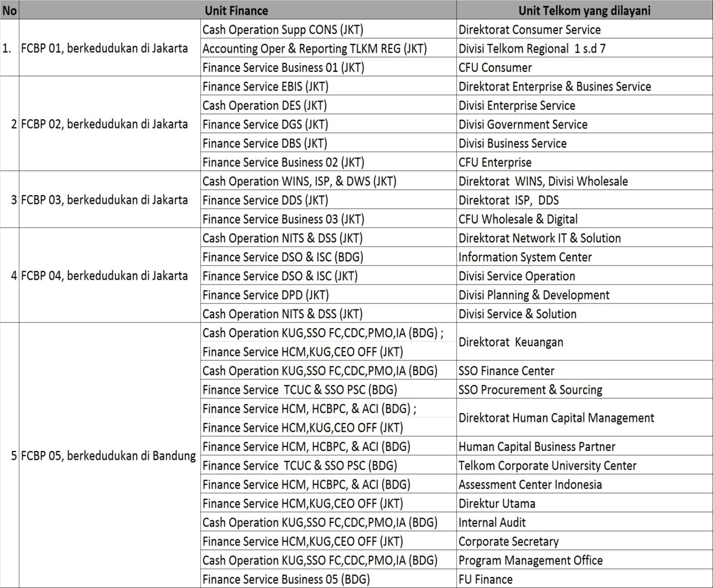
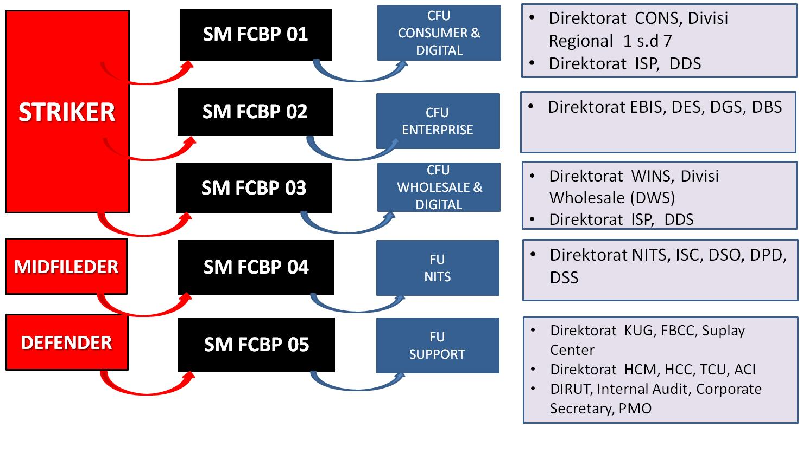
FINANCE CENTER BUSINES PARTNER (fcbp) SUPPORT CFU / FU

Slide 8
SGM SSO FINANCE CENTER
DEPUTY BILLING & REVENUE ASSURANCE
DEPUTY FINANCE & ASSET MANAGEMENT
SM
REVENUE ASSURANCE
SM
ENTERPRISE & BUSINESS BILLING
SM
CONSUMER & DIGITAL BILLING
SM
WHOLESALE & INTERNATIONAL BILLING
SM
DEBT & DUNNING MANAGEMENT
SM
CENTRALIZED PAYMENT MGT
SM
ACCOUNT RECEIVABLE MANAGEMENT
SM
FINANCE SUPPORT SYSTEM
Mgr RA Wholesale Service
Mgr RA Consumer & Enterprise Service
Mgr Operation Fraud Management
Mgr RA Framework & Performance Management
Mgr Enterprise & Business Billing Operation
Mgr Enterprise & Business Billing Data Management
Mgr Enterprise & Business Billing Support
Mgr Enterprise & Business Billing Solution
Mgr Consumer Billing Operation
Mgr Cosumer Billing Data Management
Mgr Consumer Billing Support & Solution
Mgr Digital Service & Wireless Billing
Mgr Domestic Interconnection Billing
Mgr International Interconnection Billing
Mgr Managed & Network Service Billing
Mgr Vas & Mes Billing
Mgr Wholesale Billing Data Management
Mgr Credit Control
Mgr Debt Management
Mgr Dunning Management
Mgr Revenue Account Management
Mgr Billing Information & Convergent Invoicing
Mgr Contact Center & Complain Handling
Mgr Payment Interface Operation
Mgr Payment Partnership & Readiness
Mgr Cash & Cashless Payment Mode
Mgr Digital Payment Mode
Mgr Partnership Account Management
Mgr Reconciliation & Settlement
Mgr Ar Data Management
Mgr Intercompany Settlement
Mgr Billing & Payment Application System
Mgr Financial Application System
Mgr System Compliance
Mgr System Integration Sap ERP
Mgr System Integration Billing & Payment

